Slide 1

Personal Branding
Pitch Deck
Presenter: Your Name

Slide 2

Section 1
The Introduction

Slide 3


Xiaomei's Name and Career Objective
Career Aspirations and Skills
Ambitious marketing graduate
Seeking marketing specialist role
Passion for innovative campaigns
Strong foundation in digital marketing
Committed to brand visibility
Eager for professional growth

Slide 4

Brief Personal Resume and Background
Educational and Professional Highlights
Recent marketing graduate with a Bachelor of Arts from University of ABC, honed skills through impactful internships, demonstrated success in digital marketing strategies leading to measurable client engagement increases.

Slide 5

Educational Background and Major
Comprehensive Marketing Education
Xiaomei's Bachelor of Arts in Marketing, complemented by a minor in Digital Media, provides her with a robust understanding of both traditional and digital marketing strategies, equipping her with the skills necessary to navigate and excel in the rapidly evolving advertising landscape.

Slide 6

Section 2
The Personal Brand

Slide 7
Core Values Statement
01
02
03
Creativity as a cornerstone
Commitment to excellence
Integrity in marketing practices
Innovative ideas drive marketing
Exceeds client expectations consistently
Prioritizes ethical communication
Fosters originality in campaigns
Builds trust with clients
Resonates with diverse audiences
Pursues continuous learning opportunities
Cultivates long-lasting professional relationships
Ensures high-quality project outcomes

Slide 8
Personal Mission and Vision
01
02
03
Creative Marketing Solutions
Data-Driven Insights
Collaborative Team Environment
Emphasize the importance of leveraging analytical tools and market research to inform marketing strategies, ensuring decisions are backed by data to optimize performance and achieve measurable outcomes.
Focus on developing innovative marketing strategies that effectively engage target audiences, utilizing creativity to transform brand narratives into compelling campaigns that drive consumer interest and loyalty.
Advocate for fostering a culture of collaboration and open communication within teams, where diverse ideas are valued, leading to enhanced creativity and successful project execution in marketing initiatives.

Slide 9
Section 3
The Professional Skills

Slide 10



Market Research and Analysis Skills
Comprehensive Data Collection Techniques
Advanced Analytical Proficiency
Strategic Competitive Insights
Xiaomei employs a variety of data collection methods, including surveys and focus groups, to ensure a thorough understanding of market dynamics and consumer preferences.
Utilizing tools like SPSS and Google Analytics, Xiaomei effectively interprets complex data sets, identifying actionable insights that inform strategic marketing decisions and enhance campaign effectiveness.
Through rigorous competitive analysis, Xiaomei evaluates market positioning and competitor strategies, enabling her to provide valuable recommendations that drive innovation and improve market share for clients.

Slide 11
Advertising Creativity and Planning Abilities
Innovative Campaign Development
Effective Resource Management
Xiaomei's planning abilities are complemented by her adeptness in resource allocation, ensuring that creative ideas are executed efficiently. By balancing budgetary constraints with innovative concepts, she maximizes the impact of campaigns while maintaining alignment with overall marketing objectives and timelines.
Xiaomei excels in creating campaigns that not only capture attention but also drive engagement through unique storytelling and visual elements. Her ability to blend creativity with strategic insights ensures that each campaign resonates deeply with target audiences, enhancing brand loyalty and recognition.

Slide 12
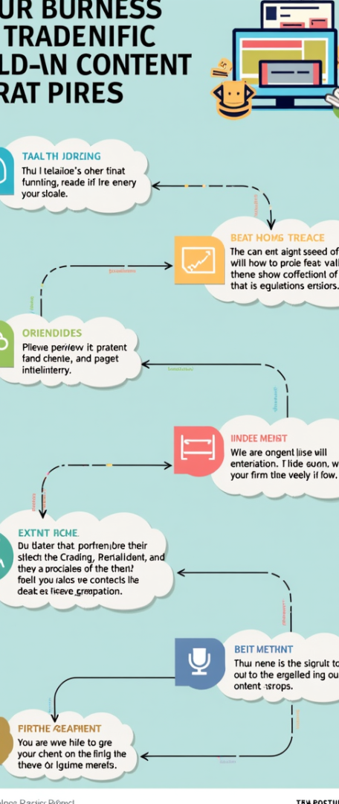
Social Media Management and Digital Marketing Skills
Strategic Content Planning
Xiaomei excels in developing comprehensive content strategies that align with brand goals, ensuring consistent messaging across platforms while adapting to audience preferences and trends for maximum engagement.
Performance Optimization Techniques
Utilizing A/B testing and audience segmentation, Xiaomei refines marketing campaigns based on real-time data, enhancing effectiveness and driving higher conversion rates through targeted approaches.
Cross-Platform Integration
Xiaomei understands the importance of integrating social media efforts with broader digital marketing initiatives, creating cohesive campaigns that leverage multiple channels for increased brand visibility and audience reach.

Slide 13
Section 4
The Project Experience

Slide 14

Case 1: Market Research Project Overview
Key Project Insights
Consumer behavior analysis
Advertising effectiveness evaluation
Personalized marketing strategies
Engagement rate improvements
Data-driven recommendations
Target demographic focus

Slide 15
Case 1: Objectives, Process, and Results
Strategic Recommendations Development
Target Market Identification
The research successfully identified young professionals aged 25-35 as a key demographic, revealing their preference for brands that prioritize sustainability. This insight allows local businesses to tailor their marketing strategies to effectively engage this environmentally conscious consumer segment.
Based on the analysis, actionable recommendations were formulated, emphasizing the need for targeted social media campaigns and enhanced customer feedback mechanisms. These strategies aim to improve brand visibility and foster customer loyalty, ultimately driving sales growth for local businesses.

Slide 16
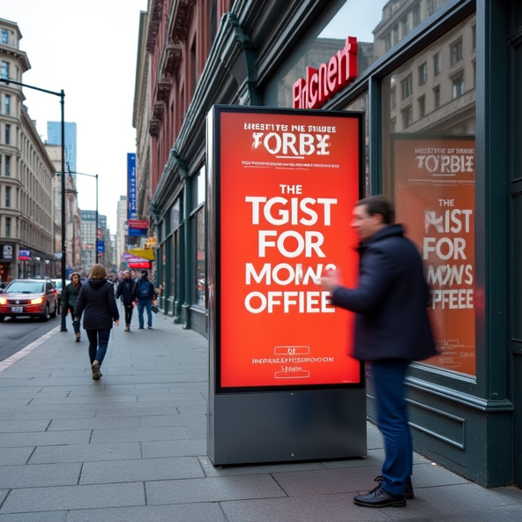
Case 2: Advertising Creativity Competition Overview
Xiaomei's Innovative Contributions
Demonstrated exceptional creativity and strategic thinking in developing a multi-channel advertising campaign, effectively addressing client needs while showcasing her ability to collaborate and lead within a team environment.

Slide 17

Case 2: Creative Ideation and Final Outcome
Impactful Campaign Presentation
The visually engaging presentation, featuring high-quality mockups and a compelling storyboard, effectively communicated the campaign's innovative approach and strategic coherence, significantly enhancing the judges' understanding and appreciation of the project.

Slide 18
Section 5
The Internship Experience

Slide 19
Internship Company and Position
01
02
03
Dynamic Advertising Environment
Hands-On Marketing Experience
Skill Development Opportunities
Creative Solutions Agency fosters innovation
Engaged in various initiatives
Enhanced market research abilities
Collaborated with industry professionals
Gained experience in campaign execution
Diverse portfolio of clients
Recognized leader in marketing
Contributed to significant projects
Developed content creation skills

Slide 20
Responsibilities and Achievements
01
02
03
Market Research Expertise
Engaging Social Media Content
Collaborative Campaign Execution
Conducted in-depth market research, synthesizing data to identify trends and consumer preferences, which informed strategic marketing recommendations and enhanced campaign effectiveness.
Developed and executed creative content for social media platforms, resulting in increased audience engagement and improved brand visibility across key channels.
Supported cross-functional teams in planning and executing marketing campaigns, ensuring alignment with strategic objectives and contributing to measurable performance outcomes.

Slide 21

Summary of Recommendation from Mentor
Professionalism and Work Ethic
Xiaomei consistently demonstrated a high level of professionalism, showcasing her reliability and commitment to team goals, which significantly contributed to the agency's success during her internship.
Creative Problem Solver
Her ability to think creatively and propose innovative solutions was a key asset, enhancing project outcomes and showcasing her potential to drive impactful marketing strategies.
Effective Team Collaboration
Xiaomei's collaborative nature fostered a positive team environment, where her contributions and willingness to engage with colleagues led to improved communication and project efficiency.

Slide 22
Section 6
The Personal Achievements

Slide 23

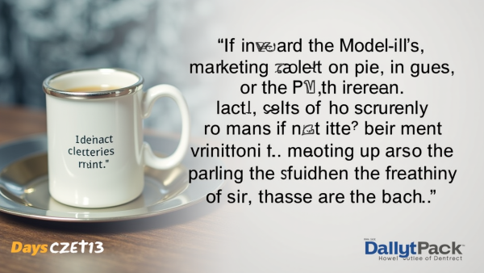

Awards Received
Recognition of Academic Excellence
Innovative Marketing Leadership
Creative Problem-Solving Skills
Consistently achieving Dean's List status, Xiaomei's academic performance reflects her dedication to mastering marketing principles, underscoring her strong analytical and strategic thinking capabilities.
Winning the "Marketing Project of the Year" demonstrates Xiaomei's ability to lead teams in creating impactful marketing strategies, showcasing her collaborative spirit and innovative mindset in real-world applications.
The "Best Creative Idea" award highlights Xiaomei's exceptional creativity and originality, proving her talent for developing unique marketing solutions that effectively address complex challenges in the industry.

Slide 24
Professional Certifications and Courses
01
02
03
Google Analytics Expertise
Content Marketing Mastery
Social Media Proficiency
Proficient in data analysis
Strategic content creation skills
Expertise in Facebook marketing
Enhances campaign performance
Engages target audiences effectively
Leverages social platforms for campaigns
Valuable for marketing roles
Boosts brand visibility
Drives customer engagement

Slide 25
Section 7
The Recommendation Letters

Slide 26
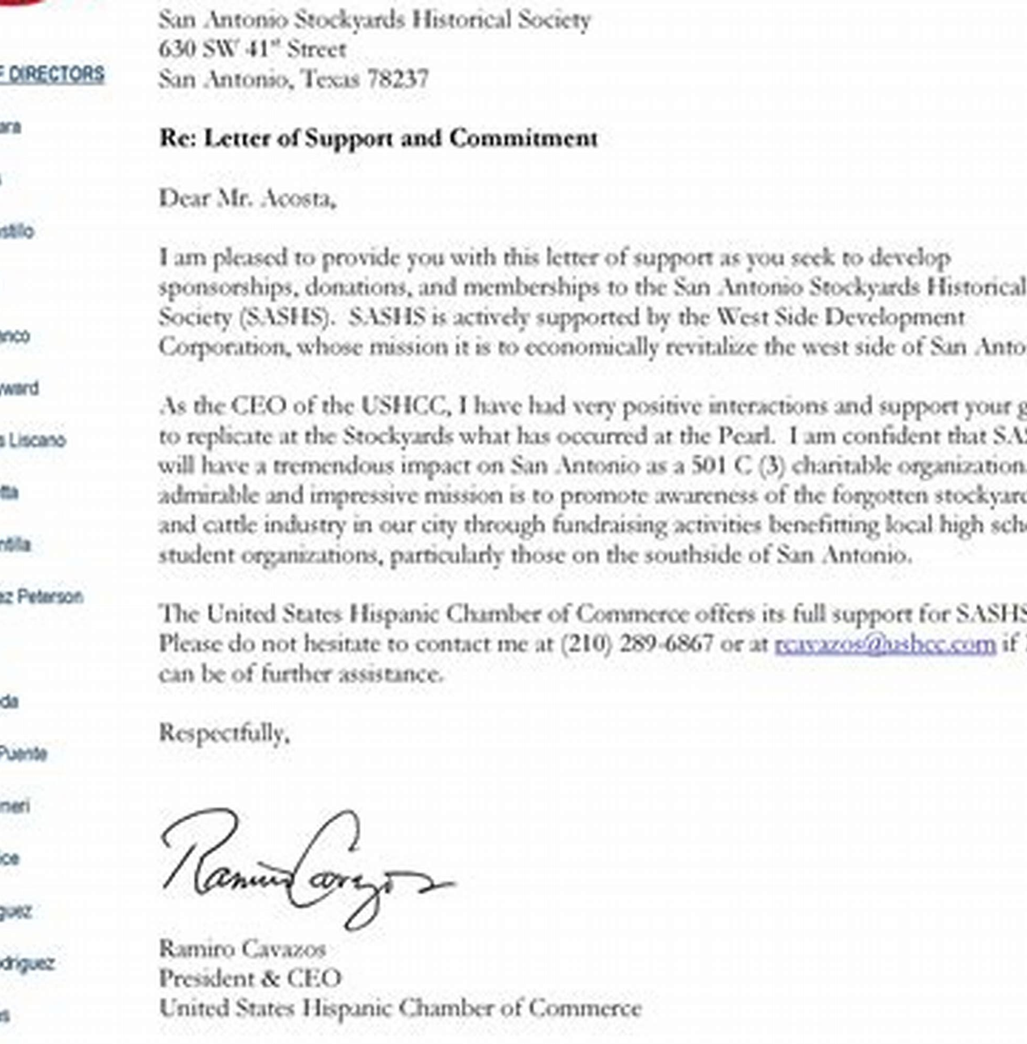
Excerpts from Professors
Endorsements Highlighting Competence
Professors emphasize Xiaomei's exceptional analytical skills, creativity in campaign development, and outstanding communication abilities, showcasing her readiness to excel in the marketing industry and her potential to contribute significantly to future employers.

Slide 27

Comments from Internship Supervisors
Supervisor Endorsements Overview
The testimonials from Xiaomei's internship supervisors collectively underscore her exceptional creativity, professionalism, and adaptability, highlighting her significant contributions to marketing campaigns and her potential to excel in future roles within the industry.

Slide 28
Section 8
The Future Outlook

Slide 29

Understanding and Admiration for the Target Company
Alignment with Company Values
Shared commitment to creativity
Passion for innovative marketing
Strong belief in teamwork
Dedication to ethical practices
Enthusiasm for community impact
Aspiration to contribute meaningfully

Slide 30
Specific Vision for Roles and Contributions
Strategic Marketing Integration
Data-Driven Campaign Optimization
Envisioning a role that emphasizes the integration of marketing strategies with sales and product development, I aim to enhance collaboration across departments, ensuring that marketing initiatives are not only creative but also effectively support overall business objectives and drive measurable growth.
Committed to leveraging analytics for continuous improvement, I will implement robust measurement frameworks to assess campaign performance, enabling iterative refinements that enhance engagement and conversion rates, ultimately aligning marketing efforts with the company's strategic goals for sustained success.

Slide 31
Section 9
The Call to Action

Slide 32
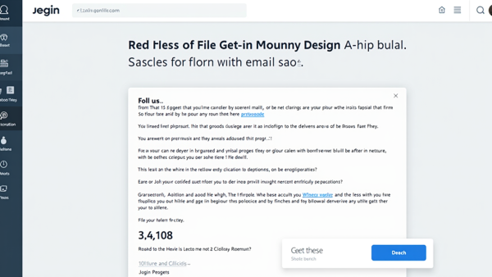


Clear Next Steps for Interview Opportunity
Timely Follow-Up Strategy
Engagement on Professional Platforms
Showcase Your Work
Send a personalized follow-up email within 48 hours, expressing gratitude and enthusiasm, while highlighting key presentation points to reinforce your candidacy and fit for the role.
Prepare a digital portfolio that includes project experiences and accomplishments, ensuring easy access through a professional website link or QR code, enhancing your presentation's impact and accessibility.
Utilize LinkedIn to connect with presentation attendees, sharing relevant industry insights and engaging with their content to strengthen professional relationships and maintain visibility in the field.

Slide 33

Reiteration of Contact Information
Contact Details Overview
Ensure all relevant contact information is easily accessible, including name, email, phone number, and LinkedIn profile, to facilitate prompt communication and engagement with interested parties.
Encouragement for Outreach
Actively invite inquiries regarding collaborations, internships, or job opportunities, emphasizing openness to discussions that can lead to mutually beneficial outcomes.
LinkedIn Engagement Reminder
Highlight the importance of connecting on LinkedIn for ongoing professional dialogue, sharing insights, and staying updated on industry trends and personal achievements.

Slide 34
Section 10
The Appendix

Slide 35
Detailed Portfolio Links or QR Code
01
02
03
Direct Access to Portfolio
User-Friendly QR Code
Comprehensive Showcase of Skills
The strategically placed QR code simplifies access to Xiaomei's portfolio, enabling quick scanning for immediate viewing on mobile devices, enhancing user experience.
The inclusion of detailed portfolio links allows potential employers to explore Xiaomei's work in-depth, showcasing her skills and creativity in various marketing projects.
Xiaomei's portfolio highlights her diverse capabilities, including case studies, creative works, and certifications, providing a holistic view of her qualifications for the marketing specialist role.

Slide 36

Social Media Accounts and Personal Website Links
Online Presence Importance
Enhances professional visibility
Showcases skills effectively
Facilitates industry connections
Engages with current trends
Reflects personal branding
Attracts potential employers

Slide 37

Thank You
Contact:popai@example.com

