Slide 1

Startup Pitch Deck
Presenter: Your Name

Slide 2

Key Pain Points in the Market
01
02
03
Limited Marketing Expertise
Resource Constraints
Data Management Challenges
SMEs lack specialized knowledge
Budget limitations hinder strategies
Overwhelmed by consumer data
Missed growth opportunities
Inability to leverage technology
Inefficient decision-making processes
Dependence on generic tactics
Insufficient personnel for execution
Difficulty extracting insights

Slide 3

Inadequacies of Current Solutions
Complexity Over Usability
Many marketing analytics tools prioritize advanced features that overwhelm SMEs, leading to underutilization and frustration due to steep learning curves and lack of user-friendly interfaces.
Siloed Data Integration
Current solutions often fail to seamlessly integrate data from multiple platforms, resulting in fragmented insights that hinder comprehensive analysis and timely decision-making for SMEs.
Generic Metrics Limitations
Existing tools typically rely on standard performance indicators that do not reflect the unique contexts of SMEs, limiting their ability to derive actionable insights and effectively measure marketing impact.

Slide 4
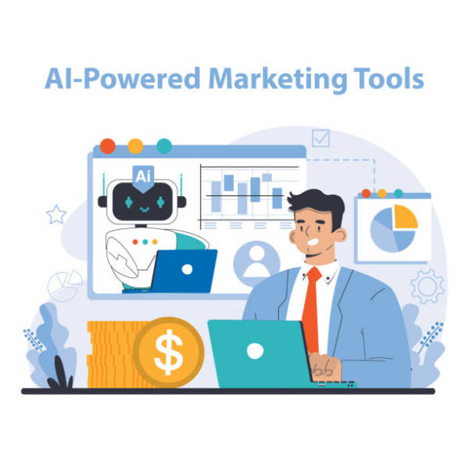
Introduction to TechGenius's Product
AI-Driven Marketing Insights
TechGenius's MarketMind utilizes advanced artificial intelligence to transform complex data into actionable marketing insights, enabling SMEs to enhance decision-making, optimize campaigns, and improve customer engagement effectively.

Slide 5
Key Features and Unique Advantages
01
02
03
Advanced AI Algorithms
User-Friendly Interface
Real-Time Analytics
Unmatched data analysis capabilities
Intuitive design for all users
Immediate performance monitoring
Simplifies navigation and comprehension
Automates marketing performance assessment
Enables swift campaign adjustments
Empowers non-technical users effectively
Continuously refines accuracy over time
Enhances decision-making agility in marketing

Slide 6
Addressing the Problem Effectively
Empowering SMEs with Insights
Streamlined Marketing Processes
TechGenius's AI marketing analytics software equips SMEs with the tools to understand consumer behavior deeply, enabling them to tailor their marketing strategies effectively. This empowerment leads to improved engagement, optimized marketing spend, and a stronger competitive position in the marketplace.
By simplifying complex data analysis, TechGenius allows SMEs to focus on strategic decision-making rather than getting bogged down by technical challenges. This streamlined approach not only enhances operational efficiency but also fosters a culture of data-driven marketing within the organization.

Slide 7

Section 2
Market Opportunity and Product Overview

Slide 8

Industry Size and Growth Expectations
Market Growth Drivers
The marketing analytics industry is experiencing rapid growth, driven by the increasing need for data-driven insights, the rise of AI technologies, and the growing adoption of cloud solutions among SMEs, positioning it for a projected market value of $6.4 billion by 2025.

Slide 9



Description of the Target Market
Diverse SMB Landscape
Growing Digital Adoption
Segment-Specific Needs
The target market includes a wide range of small and medium-sized businesses across various industries, each facing unique challenges in digital marketing and customer engagement strategies.
SMBs are increasingly adopting digital marketing solutions, driven by the necessity to enhance customer interactions and improve marketing efficiency in a competitive online environment.
Different segments within the SMB category, such as e-commerce and service providers, require tailored marketing analytics solutions to address their specific operational challenges and growth objectives.

Slide 10

Specific Opportunities Within the Market
Emerging Market Penetration
TechGenius can strategically enter emerging markets by customizing its AI-driven marketing analytics solutions to meet the unique needs of SMEs in regions like Southeast Asia and Africa, where digital transformation is accelerating and demand for accessible marketing tools is on the rise.

Slide 11

Demonstration of Key Product Features
Seamless Data Integration
Consolidates marketing efforts
Provides holistic performance view
Enables real-time decision-making
Predictive Analytics Capabilities
Anticipates customer behavior
Tailors marketing strategies
Positions businesses ahead of competition
User-Centric Design
Intuitive navigation for all
Reduces training requirements
Enhances data interpretation efficiency

Slide 12
Use Cases and Customer Experiences
01
02
03
Retail Client Success
SaaS Company Transformation
Food Brand Growth
The integration of TechGenius's platform led to a significant 30% increase in conversion rates, demonstrating the effectiveness of targeted marketing strategies based on real-time data insights.
By leveraging predictive analytics, the SaaS client achieved a 50% boost in lead generation, showcasing the platform's ability to refine content strategies and enhance audience engagement.
The food brand experienced a remarkable 300% improvement in return on ad spend, highlighting the platform's role in optimizing social media advertising through data-driven decision-making.

Slide 13
Technical Architecture and Innovations
Scalable Cloud Infrastructure
Advanced AI Capabilities
TechGenius's architecture is built on a scalable cloud framework that supports extensive data processing and storage. This design ensures high availability and performance, allowing businesses to efficiently manage large datasets while maintaining quick access to real-time analytics for informed decision-making.
The integration of sophisticated AI algorithms enables TechGenius to deliver predictive insights and automated testing features. This innovation not only enhances the accuracy of marketing strategies but also empowers users to adapt quickly to market changes, driving improved campaign effectiveness and ROI.

Slide 14

Section 3
Business Model and Go-to-Market Strategy

Slide 15
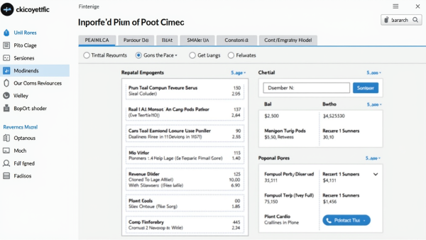
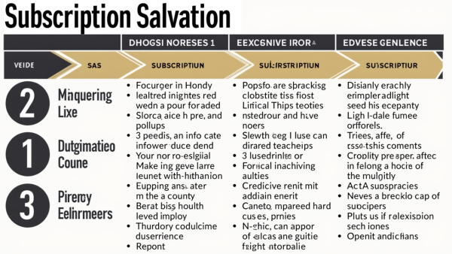

Revenue Model Overview
Diverse Revenue Streams
Predictable Cash Flow
Strategic Partnerships Impact
TechGenius's revenue model integrates multiple streams, including subscription fees, usage charges, and value-added services, ensuring financial resilience and adaptability to market demands.
The subscription-based model fosters predictable cash flow, allowing for effective financial forecasting and resource allocation, which is crucial for scaling operations and sustaining growth.
Collaborations with marketing agencies and industry players enhance revenue potential through co-branded solutions and revenue-sharing agreements, expanding market reach and service offerings.

Slide 16
Pricing Strategy and Revenue Forecasts
01
02
03
Flexible Pricing Tiers
Freemium Model Benefits
Revenue Diversification Strategy
The tiered subscription model accommodates varying SME budgets, enhancing market accessibility while maximizing revenue potential through tailored feature access for different business needs.
Introducing a freemium option encourages user engagement and acquisition, allowing potential customers to experience the product's value before transitioning to paid tiers, driving long-term revenue growth.
Incorporating add-on services and strategic partnerships will create additional revenue streams, ensuring financial stability and resilience against market fluctuations while enhancing overall profitability.

Slide 17
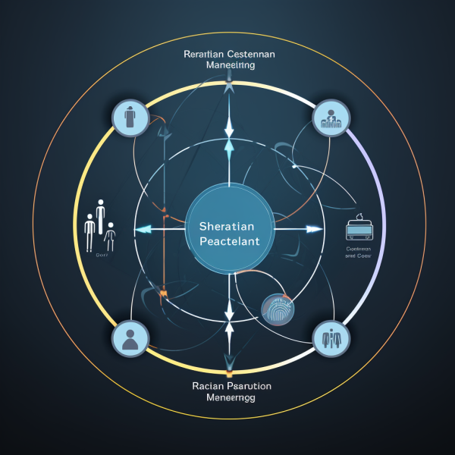
Marketing and Growth Strategies
Comprehensive Strategy Framework
Target market focus
Clear value proposition
Multi-channel engagement
Consultative sales approach
Strategic partnerships
Continuous performance monitoring

Slide 18

Customer Acquisition and Channel Strategies
Integrated Multi-Channel Approach
Employing a cohesive strategy that combines digital marketing, direct sales, and strategic partnerships will enhance TechGenius's ability to reach diverse customer segments effectively, ensuring a comprehensive engagement that maximizes lead generation and conversion rates.

Slide 19

Sales and Marketing Plans
Integrated Strategy for SMEs
TechGenius's sales and marketing plans are meticulously designed to address the unique challenges faced by SMEs, leveraging a combination of direct engagement, strategic partnerships, and targeted digital campaigns to enhance brand visibility, drive customer acquisition, and foster long-term loyalty in a competitive landscape.

Slide 20
Section 4
Market Validation and Competitive Analysis

Slide 21

Data or Case Studies Validating Market Demand
Market Demand Evidence
Significant AI market growth
70% SMEs value data analytics
60% lack necessary tools
Successful case studies demonstrate impact
Industry experts endorse AI investment
TechGenius addresses critical market gaps

Slide 22



Early Users and Feedback
User-Centric Development Approach
Impact on Product Refinement
Validation of Market Demand
TechGenius prioritizes user feedback in its development process, ensuring that product enhancements align with real-world needs and challenges faced by small and medium-sized businesses.
Insights from early users have directly influenced product features, leading to improvements in usability, functionality, and overall effectiveness of the AI marketing analytics software.
The positive experiences and testimonials from early adopters serve as strong indicators of market demand, reinforcing TechGenius's position as a valuable solution in the competitive marketing technology landscape.

Slide 23
Key Competitors
01
02
03
Diverse Competitive Landscape
User Experience Gaps
Pricing Disparities
Competitors often struggle with user-friendly interfaces, creating opportunities for TechGenius to attract SMEs by emphasizing its intuitive design and ease of use, which are critical for non-technical users.
Many competitors target larger enterprises with premium pricing, allowing TechGenius to position itself as a cost-effective alternative, appealing to budget-conscious SMEs seeking comprehensive marketing analytics solutions.
The market features a mix of established firms and innovative startups, each offering unique marketing analytics solutions, highlighting the need for TechGenius to clearly communicate its distinct advantages to potential investors.

Slide 24
Competitive Advantages and Differentiators
Innovative AI Integration
Tailored Client Engagement
TechGenius's platform utilizes cutting-edge AI technology to provide predictive analytics, enabling SMBs to anticipate market trends and customer behaviors. This proactive approach not only enhances marketing effectiveness but also empowers businesses to make informed decisions that drive growth and competitive advantage in their respective markets.
By offering extensive customization options, TechGenius ensures that its solutions align with the specific needs of each client. This personalized approach fosters stronger relationships, increases user satisfaction, and ultimately leads to higher retention rates, distinguishing TechGenius from competitors who offer one-size-fits-all solutions.

Slide 25
Section 5
Financial Projections and Funding Requirements

Slide 26
Financial Forecasts for the Next 3-5 Years
Sustained Growth and Profitability**: Continued growth anticipated, with a focus on maintaining high profit margins and customer acquisition efficiency.
Consolidation and Diversification**: Revenue reaches $3 million, supported by new features and partnerships with larger enterprises.
Expansion and Growth**: Revenue triples to $750,000 as market presence increases and customer base expands.
Year 1
Year 3
Year 5
1
2
3
4
5
6
Initial Market Penetration**: TechGenius establishes brand presence, generating $250,000 in revenue through pilot programs.
Year 2
Market Leadership Position**: Revenue doubles to $1.5 million, driven by premium offerings and enhanced customer retention strategies.
Year 4
Maturity and Establishing Global Reach**: TechGenius achieves $5 million in revenue, expanding into international markets with advanced analytics.
Year 6

Slide 27
Expected Revenue, Expenses, and Profits
01
02
03
Revenue Growth Projection
Expense Management Strategy
Profitability Timeline
TechGenius anticipates a significant increase in revenue, projecting growth from $300,000 in Year 1 to $2.5 million by Year 5, driven by a rising subscriber base and enhanced service offerings.
Total expenses are expected to rise from $250,000 in Year 1 to $1.8 million by Year 5, with strategic allocations for R&D, marketing, and customer support to ensure sustainable growth.
TechGenius aims to achieve a net profit margin of approximately 15% by Year 5, with a break-even point projected in Year 2, indicating a solid financial foundation for future expansion.

Slide 28

Key Assumptions and Financial Model
Customer Growth Projections
Initial base of 1
500 businesses
30% annual growth rate
Multi-channel acquisition strategy
Churn Rate Expectations
Initial 5% monthly churn
Stabilizing at 3% over time
Impact on recurring revenue
Revenue Model Structure
Subscription tiers at $99
$199
$499
40% basic
40% professional
20% enterprise solutions

Slide 29

Amount of Funding Needed
Funding Allocation Overview
The $1 million seed investment will be strategically allocated across key operational areas, including $400,000 for R&D to enhance AI capabilities, $300,000 for marketing initiatives to drive customer acquisition, $200,000 for essential operational expenses, $100,000 for establishing a sales infrastructure, and $100,000 reserved as a contingency fund to manage unforeseen challenges, ensuring a robust foundation for TechGenius's growth and market penetration.

Slide 30

Use of Funds and Funding Milestones
Strategic Fund Allocation
The $1 million seed funding will be meticulously allocated to ensure optimal growth, with 40% dedicated to R&D for product innovation, 30% for aggressive marketing to capture market share, 15% for essential operational costs, 10% for building a skilled sales team, and 5% reserved for unforeseen expenses, thereby establishing a solid foundation for TechGenius's success.

Slide 31
Section 6
Team and Risks

Slide 32

Introduction of Core Team Members
Diverse Expertise in Leadership
Team combines technology
marketing
operations
Unique backgrounds enhance innovation
Proven track records in startups
Strategic Vision and Execution
CEO drives overall strategy
CTO ensures technical excellence
CMO focuses on market positioning
Commitment to Growth and Success
CFO manages financial health
Head of Product Development innovates offerings
Head of Customer Success enhances client relations

Slide 33
Relevant Experience and Track Record
01
02
03
Proven Leadership Success
Innovative Product Development
Strong Industry Connections
The founding team has collectively led multiple startups to successful exits, demonstrating their ability to navigate challenges and capitalize on market opportunities effectively.
Team members have a history of launching award-winning products, showcasing their expertise in creating solutions that resonate with market needs and drive customer engagement.
The advisory board's extensive networks in technology and finance provide TechGenius with strategic advantages in securing partnerships and funding, enhancing growth potential.

Slide 34
Key Risks and Mitigation Strategies
Technical Reliability Assurance
Market Adaptability Framework
Ensuring the AI marketing analytics software's reliability is crucial. TechGenius will implement continuous integration and deployment practices, alongside automated testing frameworks, to identify and resolve technical issues proactively, thereby minimizing downtime and enhancing user trust in the product's performance and scalability.
To address market risks, TechGenius will establish a dedicated market intelligence team responsible for analyzing trends and competitor movements. This team will facilitate agile product iterations and strategic pivots, ensuring the software remains relevant and competitive in a rapidly evolving digital marketing landscape.

Slide 35
Technical, Market, and Operational Risks
01
02
03
Proactive Risk Management Strategies
Continuous Market Monitoring
Robust Talent Development Programs
Implementing a comprehensive risk management framework will enable TechGenius to identify potential risks early, allowing for timely interventions and adjustments to minimize impact on operations and market positioning.
Establishing a dedicated team for ongoing market analysis will ensure TechGenius remains responsive to shifts in consumer behavior and competitive dynamics, facilitating agile adaptations to product offerings and marketing strategies.
Investing in employee training and development will enhance team capabilities, reduce turnover, and ensure that TechGenius maintains a skilled workforce capable of navigating operational challenges effectively.

Slide 36
Section 7
Closing and Q&A

Slide 37

Summary of Key Information
TechGenius Investment Opportunity
Innovative AI solutions
Tailored for SMEs
Strong market growth
Experienced leadership team
Subscription-based revenue model
Significant funding potential

Slide 38

Contact Information
Engagement Encouraged
Stakeholders are invited to connect with TechGenius for inquiries, collaboration opportunities, and insights into innovative solutions, fostering a transparent and responsive communication channel.

Slide 39

Lead into Q&A Sessi
Invitation for Engagement
We encourage your questions and insights to foster a collaborative discussion that clarifies our vision and strengthens our partnership potential.

Slide 40

Thank You
Contact:popai@example.com

