Slide 1


Business Proposal Pitch Deck
Presenter: Your Name

Slide 2


Section 1
The Executive Summary

Slide 3


Vision and Mission of the Healthy Food Brand
Core Values and Impact
Health-centric focus
Sustainable sourcing practices
Innovative product development
Educational initiatives for consumers
Community engagement efforts
Accessibility for diverse audiences

Slide 4

Overview of the Business Model
Sustainable Growth Strategy
The business model integrates eco-friendly practices and health-focused product offerings, ensuring alignment with consumer trends towards sustainability and wellness, thereby enhancing brand loyalty and market competitiveness.

Slide 5
Target Customer Base and Market Advantages
Competitive Market Positioning
Diverse Customer Segmentation
The target customer base encompasses a wide range of demographics, including health-conscious individuals, families, and fitness enthusiasts. This diversity allows for tailored marketing strategies that resonate with each segment, enhancing engagement and fostering brand loyalty through personalized product offerings and communication.
The brand's unique value proposition, emphasizing health benefits and sustainability, positions it favorably against competitors. By addressing the rising consumer demand for nutritious options and eco-friendly practices, the brand can effectively capture market share and establish itself as a leader in the healthy food sector.

Slide 6

Funding Requirements and Utilization Plan
01
02
03
Strategic Allocation of Funds
Phased Implementation Approach
Investor Confidence and Returns
The $2 million funding will be strategically allocated to ensure comprehensive coverage of product development, marketing, and operational needs, facilitating a robust market entry and sustainable growth trajectory.
The meticulous planning of funding requirements and utilization aims to maximize investor returns by establishing a strong market presence and fostering continuous innovation in response to consumer demands.
Funds will be utilized in distinct phases, focusing first on product development, followed by marketing initiatives, and finally scaling operations, ensuring a structured and effective launch process.

Slide 7
Section 2
The Problem and Opportunity

Slide 8

Current Market Problems or Pain Points
Health Issues and Misinformation
Rising obesity rates
Misleading health claims
Demand for clean ingredients
Accessibility Challenges
Limited healthy options
Fast food prevalence
Underserved community needs
Consumer Education Gaps
Confusing food labels
Lack of nutritional knowledge
Need for informed choices

Slide 9


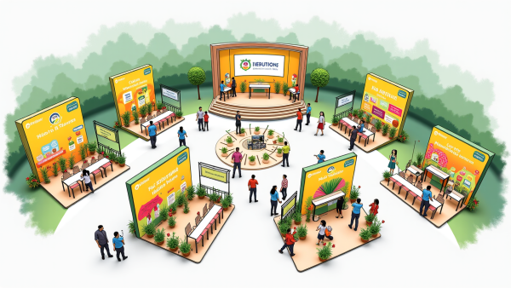
How the Brand Addresses These Issues
Curated Product Offerings
Convenient Meal Solutions
Consumer Education Initiatives
The brand provides a carefully selected range of health-focused products that prioritize nutritional value, catering to the growing consumer demand for clean, wholesome ingredients without artificial additives.
To accommodate busy lifestyles, the brand offers ready-to-eat meals and healthy snacks, ensuring that consumers can maintain nutritious eating habits without sacrificing convenience or quality.
Through workshops and online resources, the brand actively educates consumers about nutrition, empowering them to make informed dietary choices and fostering a community of health-conscious individuals.

Slide 10
Size of the Potential Market Opportunity and Market Trends
01
02
03
Market Growth Projections
Consumer Preference Shifts
Health and Wellness Demand
The global healthy food market is projected to reach USD 1.5 trillion by 2030, driven by increasing consumer awareness and demand for nutritious options, indicating a robust opportunity for new entrants.
A significant trend towards plant-based diets is emerging, with sales expected to exceed USD 20 billion by 2027, highlighting a growing market segment that aligns with our product offerings.
Post-pandemic, 31% of consumers prioritize health more than ever, creating a sustained demand for immunity-boosting and functional foods, which our brand is well-positioned to fulfill.

Slide 11
Section 3
The Solution

Slide 12

Products or Services of the Healthy Food Brand
Innovative Nutritional Solutions
The Healthy Food Brand's diverse product offerings are meticulously designed to cater to the evolving preferences of health-conscious consumers, ensuring that each item not only meets dietary needs but also enhances overall well-being through superior taste and convenience.

Slide 13
Unique Selling Points and Differentiation Strategy
Innovative Health Solutions
Sustainable Brand Practices
Our brand leverages advanced food technology to create unique product formulations that not only meet health standards but also cater to diverse dietary preferences, ensuring a delightful taste experience. This innovation positions us as a frontrunner in the competitive healthy food market, appealing to discerning consumers.
By prioritizing eco-friendly sourcing and packaging, our brand aligns with the values of environmentally conscious consumers. This commitment to sustainability not only enhances our market appeal but also establishes us as a leader in responsible food production, fostering long-term customer loyalty and trust.

Slide 14
Product Development Stages and Launch Plan
Developed initial product prototypes, focusing on flavor variety and packaging design.
Implemented post-launch strategies to enhance customer engagement and monitor market trends.
Finalized product formulations and established branding and packaging compliance.
2019
2021
2023
1
2
3
4
5
6
Initiated comprehensive market research to identify consumer preferences and dietary trends.
2020
Conducted rigorous testing phases, including sensory evaluations and nutritional analysis.
2022
Launched pre-launch marketing campaigns and secured retail partnerships for distribution.
2024

Slide 15
Section 4
The Market Analysis

Slide 16
Size and Growth Rate of the Target Market
01
02
03
Market Valuation Insights
Projected Growth Factors
Regional Growth Dynamics
Global market valued at $1 trillion
CAGR of 8-10% anticipated
North America maintains market leadership
Diverse product categories driving growth
Health consciousness driving demand
E-commerce expansion enhancing accessibility
Asia-Pacific shows rapid growth potential
U.S. leads with 30% share
Europe supports organic initiatives through regulations

Slide 17
Target Customer Segmentation
01
02
03
Health-Conscious Demographics
Fitness Enthusiast Engagement
Convenience for Busy Lifestyles
Targeting individuals aged 25-45 who prioritize organic, nutrient-rich products, this segment is crucial for driving brand loyalty and repeat purchases through tailored marketing strategies that resonate with their health goals.
Focus on urban consumers aged 18-40 who actively seek performance-enhancing nutrition, leveraging partnerships with fitness influencers to promote products that align with their active lifestyles and dietary needs.
Addressing the needs of professionals and families, this segment values quick, nutritious meal options, necessitating marketing that highlights ease of preparation and health benefits to capture their attention and drive sales.

Slide 18


Competitive Analysis and Brand’s Competitive Advantages
Strong Market Position
Limited Product Differentiation
01
02
Established brand recognition and loyalty among health-conscious consumers enhance competitive standing against rivals in the healthy food sector.
Many competitors offer similar health-oriented products, leading to challenges in distinguishing our brand in a crowded marketplace.
Growing Health Trends
Intense Competitive Pressure
03
04
Increasing consumer demand for nutritious and sustainable food options presents significant opportunities for market expansion and product innovation.
The rise of emerging brands and innovative startups intensifies competition, necessitating continuous adaptation and strategic positioning to maintain market relevance.

Slide 19
Section 5
The Marketing and Sales Strategy

Slide 20



Brand Positioning and Value Proposition
Health-Centric Brand Identity
Flavor-Forward Product Development
Commitment to Sustainability
Our brand emphasizes a health-centric identity, appealing to consumers seeking nutritious options that align with their wellness goals, thereby fostering brand loyalty and repeat purchases.
We prioritize flavor in our product development, ensuring that health-conscious consumers enjoy delicious meals without compromising on taste, enhancing overall satisfaction and brand perception.
Our dedication to sustainable practices resonates with eco-conscious consumers, reinforcing trust and loyalty while differentiating our brand in a competitive market focused on responsible consumption.

Slide 21

Marketing Promotion Strategy (Online and Offline)
Integrated Marketing Approach
Combining online and offline strategies ensures a unified brand message, enhancing consumer recognition and trust across multiple touchpoints, ultimately driving higher engagement and sales.
Targeted Campaign Execution
Utilizing data analytics to tailor marketing campaigns allows for precise targeting of demographics, maximizing the effectiveness of both digital ads and in-store promotions to reach the right audience.
Continuous Performance Evaluation
Regular assessment of marketing initiatives through key performance indicators (KPIs) enables timely adjustments, ensuring strategies remain relevant and effective in meeting evolving consumer preferences.

Slide 22

Sales Channels and Distribution Strategy
Comprehensive Channel Strategy
Online DTC sales
Third-party marketplaces
Retail partnerships
Grocery chain placements
Subscription service model
Efficient logistics management

Slide 23
Section 6
The Business Model and Revenue Model

Slide 24

Sources of Revenue
Diverse Revenue Streams
Establishing multiple revenue streams, including product sales, subscription services, and wholesale distribution, will enhance financial stability and mitigate risks associated with market fluctuations, ensuring sustainable growth and profitability for the healthy food brand.

Slide 25

Pricing Strategy
Dynamic Pricing Adjustments
Implement a flexible pricing model that allows for real-time adjustments based on market trends, competitor pricing, and consumer demand, ensuring the brand remains competitive while maximizing profitability.

Slide 26



Long-term Customer Relationships and Retention Strategies
Customer Feedback Integration
Engagement through Education
Community-Centric Initiatives
Regularly collect and analyze customer feedback to refine product offerings and enhance service quality, ensuring alignment with evolving consumer preferences and fostering long-term loyalty.
Develop educational content that informs customers about health benefits and product usage, creating a knowledgeable community that strengthens brand connection and encourages repeat purchases.
Foster a sense of belonging by creating community events and online forums, allowing customers to share experiences and engage with the brand, ultimately enhancing customer retention and loyalty.

Slide 27
Section 7
The Financial Plan

Slide 28

Revenue and Profit Forecasts
Projected Revenue Growth
Year 1 revenue at $500
000
Year 2 revenue expected at $1.5 million
Year 3 revenue forecasted to reach $3 million
Profit Margin Expectations
Year 1 profit margin at 10%
Year 2 profit margin projected to rise to 15%
Year 3 profit margin anticipated at 20%
Key Growth Drivers
Market trends favoring healthy foods
Increased brand recognition through marketing
Strategic distribution partnerships enhancing sales

Slide 29
Cash Flow Analysis
01
02
03
Importance of Cash Flow
Monitoring Cash Movements
Investor Confidence Building
Effective cash flow management is vital for the healthy food brand's sustainability, enabling timely investments and operational efficiency while ensuring the ability to meet financial obligations and capitalize on growth opportunities.
Regular tracking of cash inflows and outflows is essential to identify trends, manage liquidity, and make informed decisions that support the brand's financial health and strategic objectives.
A robust cash flow analysis demonstrates fiscal responsibility and operational viability, instilling confidence in potential investors regarding the brand's ability to generate returns and navigate market challenges effectively.

Slide 30
Financial Assumptions and Key Metrics
Market Growth Insights
Customer Value Proposition
The healthy food sector's anticipated 10% CAGR reflects a significant shift in consumer preferences towards health and wellness, indicating a robust opportunity for investment. This growth is fueled by increasing awareness of nutrition, driving demand for innovative and nutritious food products that align with modern lifestyles.
With an estimated customer lifetime value of $500, the brand's focus on quality and customer satisfaction is expected to enhance retention rates. This strong LTV, combined with a decreasing customer acquisition cost, underscores the brand's potential for sustainable profitability and long-term investor returns.

Slide 31
Section 8
The Team Introduction

Slide 32
Background and Experience of the Founding Team
01
02
03
Diverse Industry Expertise
Proven Track Records
Strategic Advisory Network
Each founder has a history of successful initiatives in their respective fields, demonstrating their ability to drive growth and innovation, which is critical for establishing a competitive edge in the market.
The founding team combines extensive backgrounds in food science, marketing, and finance, ensuring a well-rounded approach to brand development and operational efficiency in the healthy food sector.
The team is supported by a robust advisory board of industry veterans and specialists, providing valuable insights and guidance that enhance decision-making and strategic planning for the brand's future.

Slide 33

Key Team Members and Their Contributions
Collective Expertise Drives Success
Diverse skill sets enhance innovation
Strategic vision aligns with market needs
Financial acumen ensures sustainability
Operational efficiency maximizes productivity
Marketing strategies boost brand visibility
Advisory board provides industry insights.

Slide 34

Advisors and Partners
Strategic Guidance and Resources
The collaboration with seasoned advisors and strategic partners is essential for leveraging industry expertise, enhancing operational efficiency, and fostering innovation, ultimately positioning our healthy food brand for sustainable growth and competitive advantage in the market.

Slide 35
Section 9
The Funding Needs

Slide 36

Detailed Funding Plan
Comprehensive Financial Strategy
The funding plan not only outlines the required capital but also emphasizes a structured approach to financial management, ensuring that each dollar is strategically invested to maximize growth potential and achieve long-term profitability while maintaining transparency and accountability to investors.

Slide 37
Details of Fund Usage
01
02
03
Strategic Fund Allocation
Operational Cost Management
Growth-Focused Investments
$800
$200
Emphasis on quality ingredients
000 for product development
000 for administrative expenses
Strong brand identity creation
$500
$200
Efficient distribution partnerships
000 for marketing initiatives
000 for contingency fund
$300
$200
000 for sales and distribution
000 for legal compliance

Slide 38
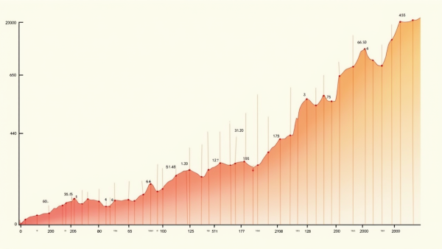

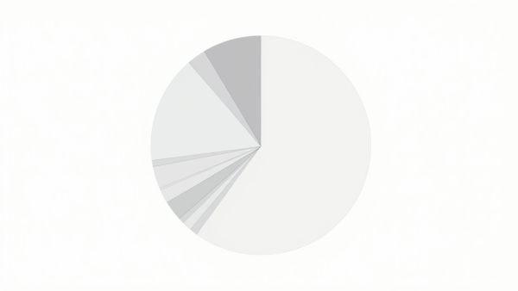
Expected Investment Returns and Exit Strategy
Projected Financial Growth
Strategic Exit Opportunities
Dividends and Profit Sharing
Investors can anticipate a robust internal rate of return (IRR) of 25% to 30% over five years, driven by a conservative annual sales growth rate of 20%.
Potential exit strategies include acquisition by larger firms, IPOs, or secondary sales, each providing investors with lucrative options to realize their investment returns effectively.
Starting in year three, dividends are expected to be distributed at a rate of 10% of profits, contingent on financial performance, enhancing investor returns as the brand matures.

Slide 39
Section 10
The Appendix

Slide 40

Supplemental Data and References
Market Research Insights
Comprehensive studies reveal a growing consumer preference for healthy food options, with significant data supporting the increasing demand for organic and nutritious products, essential for informed investment decisions.
Competitive Landscape Overview
Detailed analysis of key competitors highlights their market strategies and positioning, providing valuable insights for identifying potential gaps and opportunities for differentiation in the healthy food sector.
Regulatory Compliance Guidelines
Essential regulatory frameworks and guidelines from authoritative bodies ensure that our product offerings meet safety and labeling standards, crucial for maintaining consumer trust and facilitating market entry.

Slide 41
Detailed Market Research Reports
Comprehensive Market Insights
Competitive Landscape Evaluation
In-depth analysis of market trends reveals critical consumer behaviors, preferences, and emerging opportunities within the healthy food sector. This data-driven approach enables strategic positioning and informed decision-making, ensuring the brand effectively meets evolving consumer demands and capitalizes on market growth potential.
Detailed assessments of key competitors highlight their strengths, weaknesses, and market strategies. Understanding these dynamics allows the brand to identify gaps in the market, differentiate its offerings, and develop targeted strategies that enhance competitive advantage and foster long-term success in the healthy food industry.

Slide 42
Technical or Patent Informati
01
02
03
Intellectual Property Importance
Proactive Patent Management
Regulatory Compliance Integration
A strong IP strategy is vital for protecting innovations in formulations and processes, ensuring competitive advantage and market differentiation in the healthy food sector.
Regular monitoring of patent landscapes and competitor activities is essential for identifying potential infringements and opportunities for strategic partnerships, enhancing innovation protection.
Aligning patent strategies with regulatory requirements ensures that product claims are substantiated, fostering consumer trust and facilitating smoother market entry for new offerings.

Slide 43


Thank You
Contact:popai@example.com

