Slide 1

Creative Pitch Deck
Presenter: Your Name

Slide 2


Section 1
Introduction to GreenTech Innovations

Slide 3

Overview of GreenTech Innovations
Innovative Eco-Friendly Solutions
Pioneering sustainable technology
Addressing environmental challenges
Commitment to resource stewardship
High-quality performance standards
Customer-centric product development
Strategic market positioning

Slide 4
Mission Statement and Vision
Commitment to Sustainability
Vision for Global Impact
GreenTech Innovations is dedicated to integrating sustainability into every aspect of our operations, ensuring that our products not only meet market demands but also contribute positively to the environment. This commitment enhances our brand reputation and attracts environmentally conscious consumers and investors alike.
Our vision extends beyond product development; we aim to inspire a global movement towards sustainable practices across industries. By positioning ourselves as thought leaders, we seek to influence policy and consumer behavior, ultimately driving a significant reduction in carbon footprints worldwide.

Slide 5

Impactful Quote on Environment and Technology
Shared Responsibility for Earth
The quote by Robert Swan emphasizes the critical need for collective action in environmental stewardship, urging all stakeholders—businesses, governments, and individuals—to actively engage in sustainable practices and leverage technology as a means to combat climate change and promote ecological balance.

Slide 6
Section 2
Identifying the Problem

Slide 7

Defining the Environmental Issue
Urgency of Climate Action
Immediate action is required to combat climate change, as rising temperatures and extreme weather events threaten ecosystems and human livelihoods, necessitating innovative solutions from companies like GreenTech Innovations.
Crisis of Waste Management
The overwhelming increase in plastic and electronic waste demands urgent attention, with sustainable technologies offering pathways to reduce landfill contributions and promote recycling initiatives that protect wildlife and human health.
Resource Sustainability Challenges
The depletion of natural resources poses significant risks to biodiversity and ecological balance, highlighting the need for GreenTech Innovations to develop technologies that promote sustainable resource use and conservation efforts.

Slide 8


Statistics Highlighting Severity
01
02
03
Climate Change Impact
Waste Generation Crisis
Biodiversity Decline Statistics
Global temperature rise
Projected waste increase
Wildlife population drop
Extreme weather events
Low recycling rates
Ecosystem disruption risks
Economic losses increasing
Landfill methane emissions
Human health impacts

Slide 9

Emotional Appeal to the Audience
Human Connection to Data
By sharing compelling personal stories and testimonials, we transform abstract statistics into relatable narratives that resonate emotionally with investors, highlighting the real-world impact of their contributions to environmental sustainability.

Slide 10

Section 3
Presenting the Solution

Slide 11
Introduction to Eco-Friendly Products
01
02
03
Sustainable Product Design
Market Demand Growth
Long-Term Environmental Benefits
Eco-friendly products are engineered to minimize environmental impact, utilizing renewable resources and sustainable materials to ensure a lower carbon footprint throughout their lifecycle.
Increasing consumer awareness and preference for sustainable options create a lucrative market for eco-friendly products, positioning GreenTech Innovations to capitalize on this trend effectively.
By investing in eco-friendly technology, consumers contribute to significant reductions in pollution and resource depletion, fostering a healthier planet for future generations.

Slide 12

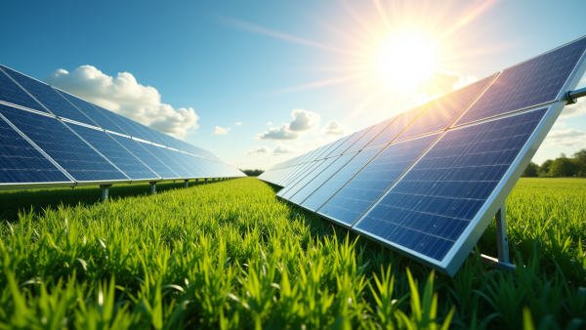


How Products Address the Problem
Sustainable Energy Solutions
Biodegradable Packaging Innovation
Smart Technology Integration
Our solar-powered appliances not only reduce energy costs but also significantly lower carbon emissions, promoting renewable energy use and enhancing energy accessibility in underserved communities.
Utilizing plant-based materials, our biodegradable packaging effectively addresses plastic waste, providing businesses with eco-friendly alternatives that decompose naturally and support sustainable practices.
Equipped with advanced smart features, our products optimize energy consumption, enabling users to monitor and manage their usage efficiently, thereby fostering a culture of sustainability and resource conservation.

Slide 13
Testimonials and Evidence of Impact
01
02
03
Client Success Stories
Quantifiable Environmental Benefits
Impactful Case Studies
Transformative sustainability partnerships
Educational opportunities for youth
Major CO2 emissions reduction
Significant cost reductions achieved
Community-driven environmental projects
Substantial water conservation metrics
Enhanced community engagement initiatives
Leadership in sustainable manufacturing
Job creation in green sectors

Slide 14
Section 4
Market Opportunity

Slide 15
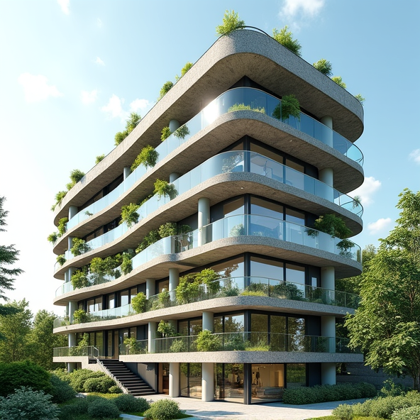
Market Research Data
Emerging Market Dynamics
The eco-friendly technology sector is experiencing transformative shifts, with a projected market value of $500 billion by 2027, driven by increasing consumer demand for sustainable solutions, government incentives, and a growing emphasis on corporate social responsibility across various industries.

Slide 16
Target Demographic and Segments
Segmented Market Opportunities
Demographic Insights
Key market segments include residential consumers, businesses, educational institutions, and government organizations. Each segment demonstrates a unique willingness to adopt sustainable technologies, presenting tailored marketing opportunities that can enhance brand loyalty and drive sales growth in the eco-friendly sector.
The target demographic for GreenTech Innovations includes environmentally conscious individuals aged 25 to 54, characterized by higher education levels and a commitment to sustainable living. This group actively seeks products that align with their values, making them prime candidates for eco-friendly technology investments.

Slide 17
Industry Trends and Future Outlook
01
02
03
Sustainability as a Competitive Edge
Technological Integration in Eco-Solutions
Global Regulatory Support for Green Initiatives
Companies prioritizing sustainability are gaining market share, as consumers increasingly favor brands that align with their environmental values, creating a significant opportunity for GreenTech Innovations to differentiate itself in a crowded marketplace.
The convergence of digital technology and eco-friendly solutions is driving innovation, enabling smarter, more efficient products that appeal to tech-savvy consumers and enhance operational efficiencies for businesses.
Governments worldwide are implementing stricter environmental regulations and offering incentives for sustainable practices, positioning GreenTech Innovations to benefit from favorable policies that encourage investment in eco-friendly technologies.

Slide 18
Section 5
Business Model

Slide 19

Revenue Generation Explanation
Diverse Revenue Streams
Product sales from eco-friendly solutions
Subscription services for ongoing engagement
Partnerships for expanded market reach
Strategic Pricing Models
Competitive analysis for market positioning
Cost-plus pricing for profitability assurance
Value-based pricing reflecting customer perception
Multichannel Sales Approach
E-commerce platform for direct sales
Retail partnerships for physical presence
B2B sales targeting institutional clients

Slide 20



Pricing Strategy and Revenue Streams
Comprehensive Pricing Analysis
Dynamic Revenue Diversification
Ongoing Pricing Optimization
Conducting thorough market research to identify customer willingness to pay, competitor pricing structures, and perceived product value will enhance pricing strategy effectiveness and market positioning.
Implementing varied revenue streams, such as product sales, subscriptions, and consulting services, will mitigate financial risks and create stable income sources for sustainable growth.
Regularly reviewing sales data and customer feedback will enable GreenTech Innovations to adjust pricing strategies dynamically, ensuring alignment with market trends and consumer expectations.

Slide 21
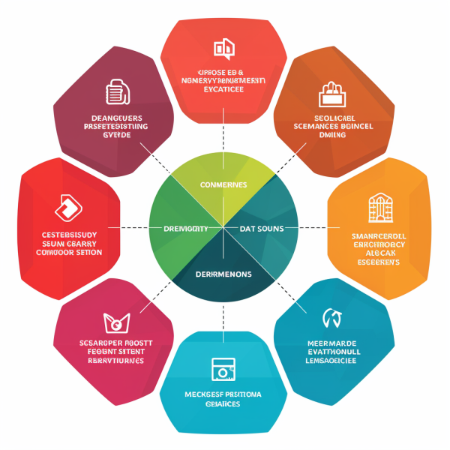
Visual Representation of Business Model
Cohesive Visual Framework
A well-structured visual representation integrates key components of the business model, such as revenue streams, pricing strategies, and customer segments, into a unified graphic that enhances investor understanding and engagement.

Slide 22
Section 6
Competitive Analysis

Slide 23

Key Competitors Overview
Strategic Market Insights
Analyzing competitors' market strategies reveals their strengths in brand loyalty, innovative product offerings, and effective supply chain management, which GreenTech Innovations can leverage to enhance its competitive positioning and identify potential gaps in the market.

Slide 24

Unique Competitive Advantages
Innovative Product Development
Cutting-edge technology integration
Sustainable design principles
Continuous R&D investment
Sustainability Commitment
Eco-friendly manufacturing processes
Reduced carbon footprint initiatives
Strong brand loyalty cultivation
Strategic Industry Collaborations
Partnerships with key organizations
Access to advanced technologies
Enhanced market credibility and visibility

Slide 25




SWOT Analysis
Innovative Product Portfolio
Brand Visibility Challenges
GreenTech Innovations offers unique eco-friendly technologies that address critical environmental challenges, enhancing market competitiveness and attracting eco-conscious consumers.
As a new entrant, the company struggles with limited brand recognition, necessitating strategic marketing efforts to establish a strong market presence against established competitors.
01
02
Expanding Sustainable Market
Regulatory Compliance Risks
03
04
Potential changes in environmental regulations may impose additional operational costs, impacting profitability and necessitating agile responses to maintain compliance and market relevance.
The rising global demand for sustainable products presents significant growth opportunities, allowing GreenTech to capitalize on consumer trends favoring eco-friendly solutions.

Slide 26
Section 7
Financial Projections

Slide 27
Projected Revenue and Expenses
Expense Management Focus
Revenue Growth Strategy
GreenTech Innovations plans to leverage strategic marketing initiatives and partnerships to enhance brand visibility, targeting eco-conscious consumers. This approach is expected to drive revenue growth significantly, with projections indicating a steady increase in sales as market demand for sustainable technology solutions expands.
The company emphasizes disciplined expense management to ensure profitability while investing in growth. By prioritizing research and development, marketing, and operational efficiencies, GreenTech Innovations aims to maintain a healthy balance between revenue generation and cost control, fostering long-term financial sustainability.

Slide 28
Key Financial Metrics and ROI
01
02
03
Revenue Growth Projections
Profitability Indicators
Investment Return Potential
Anticipated revenue growth reflects a strategic response to market demand, with a forecasted increase from $1.5 million in Year 1 to $10 million by Year 5, driven by innovative product offerings and expanding market reach.
A projected gross margin of 60% and a net income margin stabilizing at 10% by Year 5 highlight the company's operational efficiency and commitment to maintaining profitability while scaling operations.
With an expected ROI exceeding 300% by Year 5, driven by strong revenue growth and strategic exit opportunities, GreenTech Innovations presents a compelling investment case for potential stakeholders.

Slide 29



Visual Aids for Financial Data
Enhancing Data Comprehension
Engagement Through Design
Supporting Narrative Flow
Integrating visuals with the narrative enhances storytelling, ensuring that each visual element reinforces key financial messages, ultimately leading to a more persuasive and cohesive presentation.
Visual aids simplify complex financial data, allowing investors to quickly identify trends and insights, thereby improving their understanding and retention of critical information presented.
Well-designed visuals capture investor attention, making presentations more engaging and memorable, which increases the likelihood of discussions and follow-up inquiries regarding financial projections.

Slide 30
Section 8
The Team

Slide 31
Founding Team Introduction
01
02
03
Diverse Expertise and Vision
Collaborative Culture
Commitment to Learning
The founding team combines backgrounds in environmental science, engineering, marketing, and finance, ensuring a well-rounded approach to tackling eco-friendly technology challenges and driving innovation.
Emphasizing teamwork and shared values, the team fosters an environment that encourages creativity and diverse perspectives, enhancing problem-solving capabilities and strategic decision-making.
The team actively pursues ongoing education and industry engagement, ensuring that GreenTech Innovations remains at the forefront of sustainable technology advancements and responsive to market changes.

Slide 32

Relevant Experience and Skills
Team's Diverse Expertise
Technology innovation backgrounds
Financial management proficiency
Strategic marketing experience
Environmental science knowledge
Operations optimization skills
Legal compliance expertise

Slide 33

Professional Headshots and Bios
Visual Identity and Trust
Professional headshots and well-crafted bios are essential in establishing a credible and relatable team image, enhancing investor confidence by showcasing the unique qualifications and shared commitment of each member to the mission of GreenTech Innovations.

Slide 34
Section 9
Milestones and Traction

Slide 35

Key Milestones Achieved
Strategic Growth Initiatives
GreenTech Innovations has successfully established a robust framework for future expansion, including the development of a five-year strategic roadmap that focuses on market penetration, product diversification, and enhanced operational efficiencies, positioning the company to capitalize on emerging opportunities in the sustainable technology sector.

Slide 36
Future Milestones and Growth Strategies
01
02
03
Strategic Product Launch Timeline
Partnership Development Goals
International Market Expansion Plans
Finalize flagship product development
Establish five strategic collaborations
Target Europe and Latin America
Launch within twelve months
Focus on sustainability-oriented organizations
Adapt marketing strategies for local preferences
Incorporate customer feedback for improvements
Enhance market reach through alliances
Increase global brand presence by Year Five

Slide 37
Timeline or Roadmap
Launched product beta, gathering critical feedback from early adopters to refine offerings before official release.
Formed a strategic partnership with an environmental organization, enhancing distribution and credibility in the sector.
Achieved significant revenue growth, validating business model and attracting further investment opportunities.
Year 1 (Q1)
Year 2 (Q1)
Year 3 (Q2)
1
2
3
4
5
6
Initiated research and development for eco-friendly technology solutions, laying the groundwork for future innovations.
Year 1 (Q4)
Officially entered the market with eco-friendly products, establishing brand presence and initial customer base.
Year 2 (Q3)
Expanded product line in response to market demand, solidifying position as a comprehensive eco-friendly solution provider.
Year 3 (Q4)

Slide 38
Section 10
Investment Ask

Slide 39



Funding Amount Requested
Investment Purpose Overview
Strategic Fund Allocation
Projected Financial Returns
Funds will be allocated to product development (50%), marketing (30%), and talent acquisition (15%), with a small portion for operational costs, ensuring comprehensive growth and sustainability.
Investors can expect a robust ROI exceeding 150% within five years, supported by increasing market demand for eco-friendly technologies and strategic growth initiatives undertaken by GreenTech Innovations.
The $5 million investment will drive product innovation, enhance marketing efforts, and expand our skilled workforce, ensuring GreenTech Innovations meets growing market demands effectively.

Slide 40
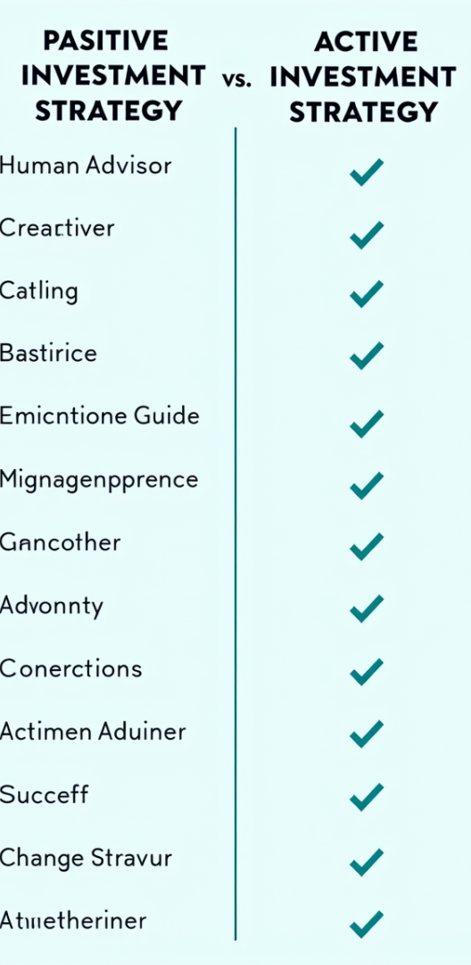
Allocation of Funds
Strategic Investment in R&D
Allocating 40% of funds to product development ensures continuous innovation, enhancing product offerings and maintaining competitive advantage in the eco-friendly technology market.
Robust Marketing Initiatives
A 30% allocation for marketing will amplify brand visibility, engage target demographics, and drive customer acquisition through strategic digital campaigns and public relations efforts.
Talent Acquisition and Training
Investing 20% in hiring and team development will build a skilled workforce, fostering expertise in sustainable technologies and ensuring operational excellence for long-term growth.

Slide 41
Potential Returns and Exit Opportunities
Strong ROI Projections
Diverse Exit Strategies
GreenTech Innovations anticipates a compounded annual growth rate (CAGR) exceeding 25% over the next five years, driven by strategic market penetration and innovative product offerings. This growth trajectory positions investors for substantial returns, with revenue projected to increase from $1 million to $10 million within this period.
Investors can explore multiple exit avenues, including acquisition by larger corporations seeking sustainable technology integration, or an initial public offering (IPO) once significant revenue milestones are achieved. These options provide flexibility and potential for lucrative returns aligned with investor goals.

Slide 42
Section 11
Call to Action

Slide 43

Inspiring Closing Message
Empowerment Through Investment
Investing in GreenTech Innovations not only supports the development of sustainable technologies but also empowers you to be a catalyst for change, ensuring that your financial contributions lead to tangible environmental benefits and a legacy of responsible innovation for future generations.

Slide 44
Next Steps for Investors
01
02
03
Thorough Review Required
Engage for Clarity
Schedule Follow-Up Meetings
Analyze pitch deck thoroughly
Initiate open dialogue
Arrange virtual or in-person sessions
Understand market opportunities
Direct questions to team
Discuss specific interests
Assess financial projections
Gain deeper insights
Explore partnership opportunities

Slide 45

Memorable Visual Reinforcing Mission and Visi
Visual Storytelling Impact
Effective visuals not only enhance the aesthetic appeal of the pitch deck but also serve as powerful tools for storytelling, allowing GreenTech Innovations to convey its mission and vision in a way that resonates emotionally with investors, fostering a deeper connection to the brand's commitment to sustainability and innovation.

Slide 46
Thank You
Contact:popai@example.com

