Slide 1

Sales Pitch Deck
Presenter: Your Name

Slide 2


Overview
Product introduction
Problem & Solution
Market opportunity
Business Model and Traction
Competitive Landscape
Marketing and Sales Strategy

Slide 3

Section 1
Product introduction

Slide 4

Product Introduction
Product Name
Product Statement
Key features
Audience Fit

Slide 5
Section 2
The Problem and Solution

Slide 6

Defining the Problem
Core Issue Identification
Thoroughly analyze industry dynamics to pinpoint specific challenges faced by target clientele, ensuring a clear understanding of operational inefficiencies and market gaps that necessitate urgent solutions.

Slide 7


Supporting Data and Testimonials
01
02
03
Robust Supporting Data
Credible Client Testimonials
Compelling Narrative Creation
70% of companies face inefficiencies
Logistics firm reduced delays by 50%
Data highlights urgency of issues
30% performance increase with solutions
Manufacturer improved inventory turnover by 35%
Testimonials reinforce trust in solutions
65% more competitive with technology
Positive user experiences validate solutions
Empirical evidence supports proposed offerings

Slide 8

Introducing Our Solution
Innovative Technology Integration
Customer-Centric Adaptability
Designed with flexibility in mind, our solution evolves alongside market demands. This adaptability allows businesses to scale operations seamlessly, ensuring that they remain responsive to changing needs while maximizing resource allocation and minimizing operational costs for sustained growth and success.
Our solution leverages state-of-the-art technology to streamline operations, ensuring that clients can efficiently manage their workflows. By automating routine tasks, we empower users to focus on strategic initiatives, ultimately driving productivity and enhancing overall business performance in a competitive landscape.

Slide 9
Unique Selling Proposition
01
02
03
Highlight Distinctive Features
Engage Target Demographic
Establish Trust and Credibility
Emphasize unique attributes of the product or service that competitors lack, such as innovative technology or exclusive benefits that directly address customer needs and preferences.
Tailor the USP to resonate with the specific values and pain points of the target audience, ensuring that the message is relevant and impactful for potential clients.
Support the USP with concrete evidence, including testimonials and case studies, to reinforce the brand's reliability and enhance customer confidence in making purchasing decisions.

Slide 10
Section 2
Market Opportunity and Product Overview

Slide 11


Market Research Insights
Consumer Preference Shift
Recent studies show a growing demand for brands that prioritize sustainability and social responsibility, with 75% of consumers favoring such companies, indicating a need for alignment with these values in product offerings.
E-commerce Growth
The rise of online shopping is evident, with 82% of consumers now preferring digital platforms for purchases, emphasizing the necessity for businesses to enhance their e-commerce strategies and digital marketing efforts.
Market Expansion Potential
The industry is projected to grow significantly, with a current market value of approximately $X billion and a CAGR of Y%, driven by increased disposable incomes and heightened consumer awareness of product benefits.

Slide 12
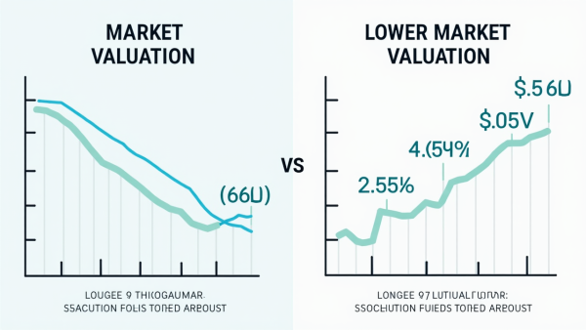


Market Size and Growth Projections
Current Market Valuation
Rapid Growth Drivers
Future Market Trends
The market is currently valued at approximately $X billion, reflecting diverse consumer segments and highlighting significant opportunities for targeted marketing and strategic engagement across various demographics.
Key growth factors include technological advancements and shifting consumer preferences towards sustainability, indicating a strong potential for market expansion and increased demand for innovative solutions.
Projections indicate a CAGR of X% from [starting year] to [ending year], driven by emerging trends such as digital transformation and geographical expansion into high-growth regions, enhancing competitive positioning.

Slide 13
Key Features and Benefits of Our Product/Service
User-Centric Innovation
Tailored Solutions for Clients
Our product's design prioritizes user experience, integrating advanced technology that simplifies navigation and interaction. This focus on usability not only accelerates onboarding for new users but also enhances overall satisfaction, leading to increased productivity and a more efficient workflow within organizations.
Extensive customization options allow clients to adapt our product to their specific operational needs. This personalized approach not only improves performance but also fosters a sense of ownership among users, ultimately driving engagement and maximizing the value derived from our service.

Slide 14
Visual Demonstrations and Testimonials
Impactful Video Content
Engaging videos showcase product benefits
Real-life scenarios enhance relatability
Concise information boosts understanding
Interactive Live Demos
Real-time demonstrations foster engagement
Step-by-step walkthroughs clarify functionality
Audience questions deepen comprehension
Credible Customer Endorsements
Testimonials provide social proof
Case studies illustrate real-world success
Expert endorsements enhance product credibility

Slide 15
Section 3
Business Model and Traction

Slide 16
Revenue Generation and Pricing Strategy
01
02
03
Diverse Revenue Streams
Strategic Pricing Models
Data-Driven Insights
Utilizing advanced analytics for pricing decisions allows for continuous refinement based on market trends and customer feedback, ensuring responsiveness to evolving consumer needs.
Implementing multiple revenue channels, including direct sales, subscriptions, and licensing, ensures financial resilience and mitigates risks associated with market fluctuations.
Employing value-based, tiered, and dynamic pricing strategies aligns customer perceptions with profitability, enhancing market competitiveness and customer satisfaction.

Slide 17
Sales and Distribution Channels
01
02
03
Comprehensive Channel Strategy
Targeted Marketing Initiatives
Performance Metrics Tracking
A multi-channel approach integrates direct sales, online platforms, and distribution partnerships, ensuring broad market coverage and enhanced customer accessibility to products.
Tailored marketing campaigns for each channel will optimize engagement, leveraging data analytics to refine strategies based on customer behavior and preferences.
Implementing robust analytics tools will allow for continuous monitoring of sales performance across channels, facilitating timely adjustments to strategies for improved outcomes.

Slide 18
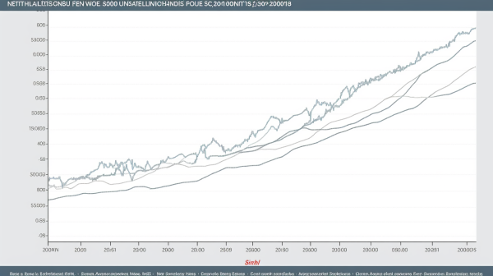
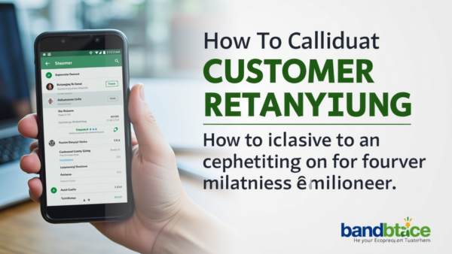

Key Metrics and Achievements
Revenue Growth Visualization
Customer Acquisition Insights
Market Penetration Analysis
Sharing market share percentages and comparative growth against industry averages demonstrates the company's competitive positioning and potential for further expansion within the target market.
Presenting a clear graph of revenue growth over the past few years highlights the company's upward trajectory, reinforcing market demand and stakeholder confidence in future profitability.
Detailed statistics on customer acquisition rates, including retention and upsell metrics, illustrate the effectiveness of marketing strategies and the strength of customer loyalty in driving sustainable growth.

Slide 19

Notable Partnerships and Clients
Strategic Collaborations Impact Growth
Enhanced service offerings
Access to advanced technologies
Joint research initiatives
Increased brand visibility
Diverse client portfolio
Strengthened market credibility

Slide 20
Section 4
Competitive Landscape

Slide 21

Identifying Main Competitors
Comprehensive Competitor Analysis
Conduct a systematic evaluation of competitors by analyzing their market strategies, product offerings, and customer engagement practices to identify gaps and opportunities for differentiation in your own business approach.

Slide 22

Competitive Comparison
Thorough Competitor Evaluation
Conduct an in-depth analysis of both direct and indirect competitors, focusing on their product features, pricing strategies, customer service quality, and market positioning to identify areas for differentiation and strategic advantage.

Slide 23



Highlighting Our Competitive Advantage
Distinctive Market Positioning
Advanced Technological Integration
Proactive Customer Engagement
Our unique market positioning is reinforced by a deep understanding of customer preferences, enabling us to tailor our offerings and create a compelling brand narrative that resonates with consumers.
We leverage cutting-edge technology to enhance product functionality and user experience, ensuring our solutions remain relevant and appealing to a tech-savvy audience seeking innovation and efficiency.
Our commitment to proactive customer engagement fosters loyalty and trust, as we prioritize personalized communication and support, setting us apart from competitors who adopt a more transactional approach.

Slide 24
Section 5
Marketing and Sales Strategy

Slide 25
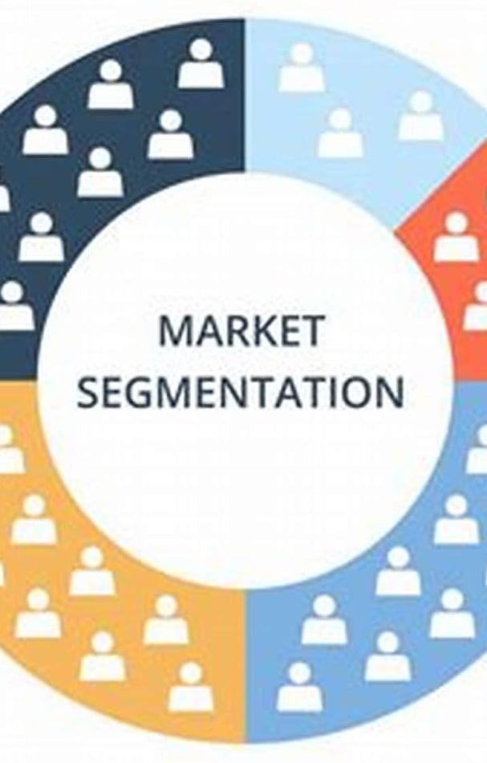
Go-to-Market Strategy
Target Market Analysis
Identify key demographics
Assess psychographic profiles
Segment geographic landscapes
Value Proposition Development
Highlight unique product benefits
Address customer pain points
Differentiate from competitors
Marketing Channel Selection
Utilize multi-channel approach
Incorporate digital and offline tactics
Drive customer engagement effectively

Slide 26
Customer Acquisition and Retention Plans
Loyalty and Retention Initiatives
Strategic Market Engagement
Implementing targeted marketing strategies that leverage data analytics to identify and engage potential customers effectively. This includes personalized outreach and tailored content that addresses specific pain points, enhancing the likelihood of conversion and fostering a deeper connection with the brand.
Establishing comprehensive loyalty programs that reward repeat customers, coupled with regular feedback mechanisms to assess satisfaction levels. This proactive approach not only encourages ongoing patronage but also provides valuable insights for continuous improvement in service delivery and customer experience.

Slide 27
Marketing Channels and Sales Tactics
01
02
03
Integrated Marketing Approach
Data-Driven Decision Making
Customer-Centric Engagement
Employ a cohesive strategy that combines traditional and digital marketing channels to enhance brand visibility and engagement across diverse customer segments, ensuring a comprehensive reach.
Utilize analytics to assess the effectiveness of marketing channels and sales tactics, allowing for real-time adjustments and optimization of campaigns based on customer behavior and preferences.
Focus on building relationships through personalized communication and targeted outreach, ensuring that marketing efforts resonate with the specific needs and interests of potential clients.

Slide 28
Section 6
Conclusion and Q&A

Slide 29

Summary of Key Points
Key Takeaways Recap
Presentation purpose clarified
Problem and solution outlined
Market opportunity highlighted
Business model explained
Competitive advantages emphasized
Funding request detailed

Slide 30

Reinforcing the Value Proposition
Effective Communication Techniques
Utilize storytelling and relatable scenarios to illustrate the value proposition, making it more memorable and impactful for the audience, thereby enhancing their emotional connection to the product or service.

Slide 31

Call to Action
Clear Next Steps
Clearly articulate the specific actions you want the audience to take post-presentation, such as scheduling a follow-up meeting or signing up for a trial, to eliminate ambiguity and facilitate immediate engagement.

Slide 32
Preparing for Audience Questions
01
02
03
Understanding Audience Needs
Anticipating Potential Inquiries
Practicing Effective Responses
Research audience backgrounds
Categorize common questions
Conduct mock Q&A sessions
Identify key interests
Prepare clear answers
Focus on clarity and conciseness
Tailor responses accordingly
Address concerns proactively
Engage with audience actively

Slide 33

Thank You
Contact:popai@example.com

